Slide 1
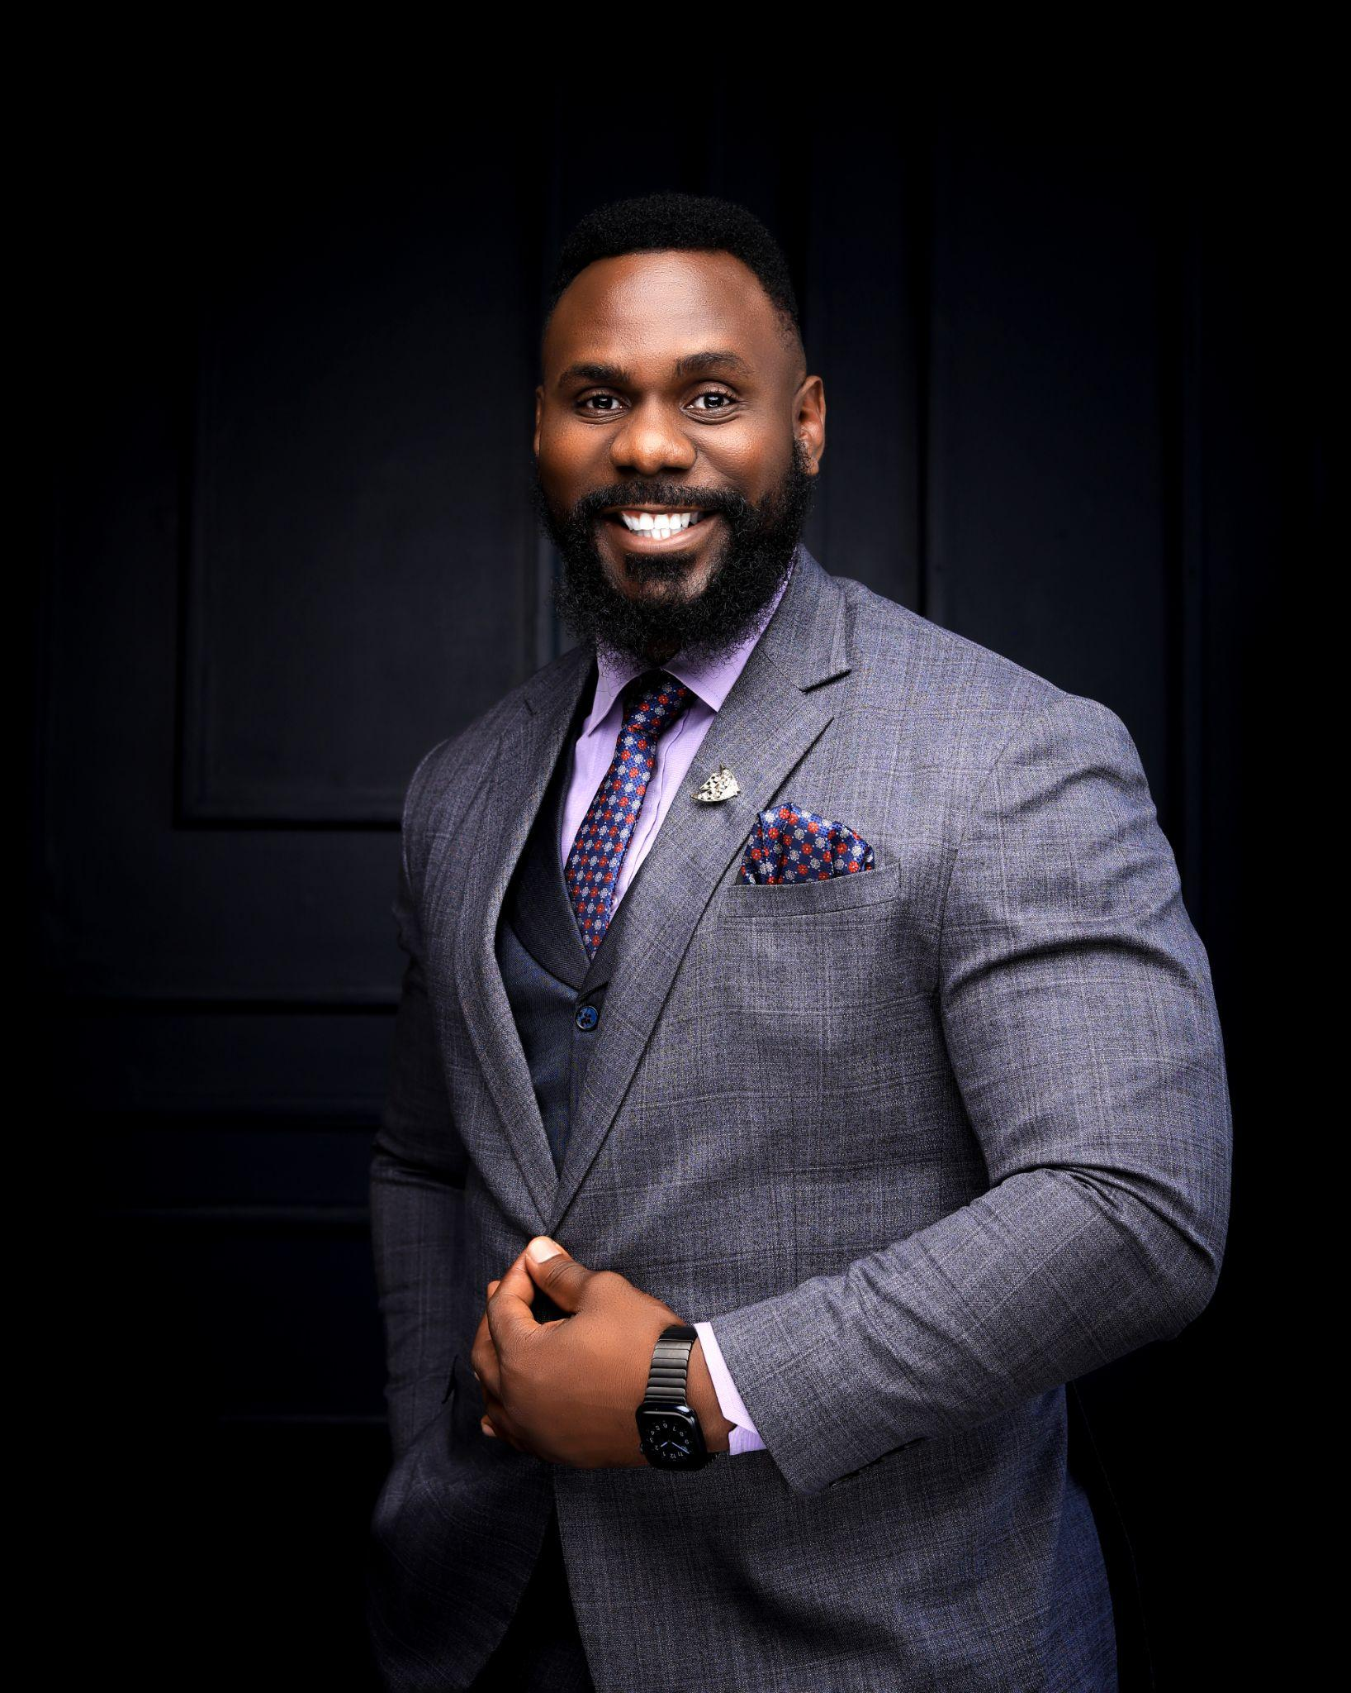
RTN. SAMUEL LUBWAMA, ACIM, CL
WORK EXPERIENCE:
12 years of Sales and Marketing Experience in Telecom, ISPs, and Real Estate Industries (Airtel, Liquid Intelligent Technologies, Sombha Solutions Store, Datanet, One Solutions Ltd, Adhere Systems, Bulooka Uganda Ltd)
15 years of Professional Experience in the Entertainment Industry (Singer, Voice & Visual Actor, Commercial Model)
Founder of Canaan Gents Vocal Band.
Founder and Executive Director of Chronaforge Enterprises.
EDUCATION & CERTIFICATIONS:
PMP (Ongoing)
CIM Level 7 Postgraduate Diploma in Professional Marketing (Ongoing) – UK
CIM Level 7 Postgraduate Diploma in Sustainable Global Marketing (Ongoing) –UK
New CIM Level 6 Diploma in Professional & Digital Marketing – UK
CIM Level 6 Award in Brand Proposition – UK
CIM Level 6 Award in Societal Impact – UK
CIM Level 6 Award in Strategy and Planning – UK
Specialist Award in Content Strategy –UK
CIM Level 6 Award in Professional & Digital Marketing –UK
ESG Training - Brentwood, UK
Carbon Literacy - Manchester, UK
Bachelor of Information Technology - Uganda Christian University
Cisco Certified Network Associate (CCNA) - Aptech
MEMBERSHIPS:
The Chartered Institute of Marketing
Rotary International
VOLUNTEER ROLES:
Vermillion Foundation - Autism Awareness and Community Outreach Lead
Rotary Club of Kampala Sunshine - Public Relations Directorate Member & PR Chair Elect
The Stanbic Black Pirates Rugby Club - Rugby Player
CONTACT:
lubwamasamuel68@gmail.com
+256703479859
+256779015006

Slide 2
REMMY BISIMBEKO, MSc. Data Science and Analytics
WORK EXPERIENCE:
12 years of Sales and Marketing Experience in Telecom, ISPs, and Real Estate Industries (Airtel, Liquid Intelligent Technologies, Sombha Solutions Store, Datanet, One Solutions Ltd, Adhere Systems, Bulooka Uganda Ltd)
15 years of Professional Experience in the Entertainment Industry (Singer, Voice & Visual Actor, Commercial Model)
Founder of Canaan Gents Vocal Band.
Founder and Executive Director of Chronaforge Enterprises.
EDUCATION & CERTIFICATIONS:
PMP (Ongoing)
CIM Level 7 Postgraduate Diploma in Professional Marketing (Ongoing) – UK
CIM Level 7 Postgraduate Diploma in Sustainable Global Marketing (Ongoing) –UK
New CIM Level 6 Diploma in Professional & Digital Marketing – UK
CIM Level 6 Award in Brand Proposition – UK
CIM Level 6 Award in Societal Impact – UK
CIM Level 6 Award in Strategy and Planning – UK
Specialist Award in Content Strategy –UK
CIM Level 6 Award in Professional & Digital Marketing –UK
ESG Training - Brentwood, UK
Carbon Literacy - Manchester, UK
Bachelor of Information Technology - Uganda Christian University
Cisco Certified Network Associate (CCNA) - Aptech
MEMBERSHIPS:
The Chartered Institute of Marketing
Rotary International
VOLUNTEER ROLES:
Vermillion Foundation - Autism Awareness and Community Outreach Lead
Rotary Club of Kampala Sunshine - Public Relations Directorate Member & PR Chair Elect
The Stanbic Black Pirates Rugby Club - Rugby Player
CONTACT:
Bisremmy.rb@gmail.com
+256701650461
+256752601038

